Slide 1

Ambiguous Grammar
CSE420 : Compiler Design
Week 3 Lecture 2
Part 1

Slide 2
“It is not possible to produce a set of rules purporting to describe what a man should do in every conceivable set of circumstances.”
- Alan Turing, Computing Machinery and intelligence

Slide 3
Definition of Ambiguous Grammar
- Grammars are divided two parts based on the number of derived trees
Ambiguous
Unambiguous
“A grammar can have more than one parse tree generating a given string of terminals. Such a grammar is said to be ambiguous” [ Compilers: Principle Techniques, and Tools; 2nd Edition]

Slide 4
Definition (Contd.)
Ambiguous Grammars produce either one or more or all of the below:
More than one Parse Tree
More than one Derivation Tree
More than one Syntax Tree
More than one Leftmost Derivation
More than one Rightmost Derivation

Slide 5
Definition(Contd.)
Example:
Grammar: E → E + E | E *E | id
[Compilers: Principle Techniques, and Tools; 2nd Edition page 203 ]
Sentence : id + id *id
Left Derivation 1 : E → E + E E → id + E E → id + E * E E → id + id * E E → id + id * id | Left Derivation 2: E → E * E E → E + E * E E → id + E * E E → id + id * E E → id + id * id

Slide 6
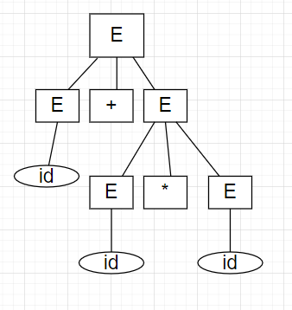
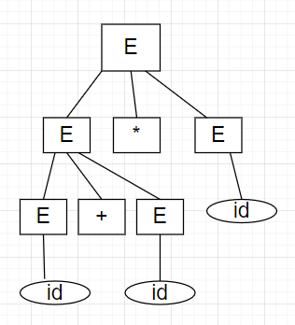
Definition(Contd.)
Parse Tree 1
Parse Tree 2

Slide 7
Practice Problem
Try the same with
Rightmost Derivation
Syntax Tree

